Slide 1
Cladogram of taxa analysed for Blattabacterium HGT events
Number of HGT inserts
Nodes show divergence times (Ma) from Beasley-Hall et al (2021: for nodes internal to top 12 taxa) and Evangelista et al (2019: for nodes internal to remaining 6 taxa). One exception is value between P. lata
and P. cribrata, which is from Adams et al 2024.
6.67
Macropanesthia lithgowae Z004 (Murgon)
5037
12.73
Panesthia tryoni tryoni Z005 (Kroombit Tops)
4252
5.84
Panesthia gigantea Z020 (location TBD)
3852
14.12
Panesthia tryoni tegminifera Z011 (Washpool)
3702
20.91
13.17
Neogeoscapheus dahmsi Z014 (location TBD)
4716
Panesthia tryoni tryoni Z012 (Eungella)
4086
22.84
Geoscapheus dilatatus (Gilgandra)
4396
28.71
17.35
Panesthia sloanei Z001 (Mt Baldy)
2964
Neogeoscapheus hanni (Mt Molloy)
2797
63.05
1.81
Panesthia cribrata (North Manly)
1543
145
Panesthia lata M001 (Lord Howe Island)
1601
Diploptera punctata
532
Blattella germanica
527–609
207
45
Reticulitermes lucifugus
8
Kyle and Maxim:
Are these termite numbers
right? When I did an audit in early 2025 I found none were Blattabacterium?
98
Coptotermes formosanus
0
108
Termites
Cryptotermes secundus
0
161
Zootermopsis nevadensis
1-74
Periplaneta americana
106-647

Slide 2
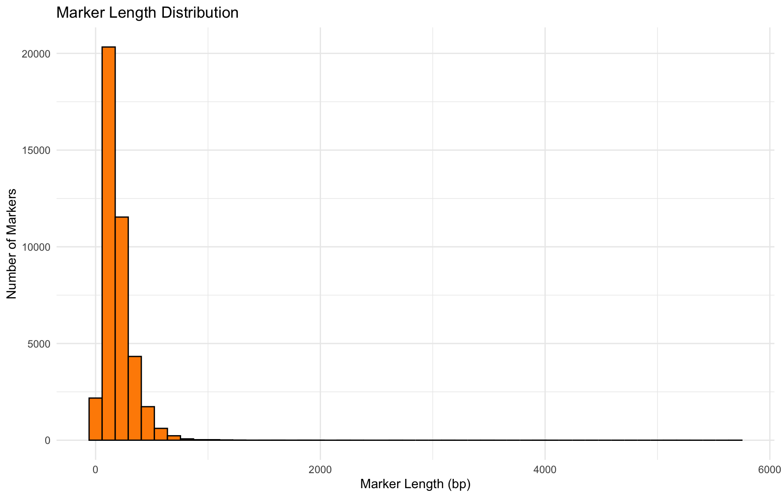

Slide 3
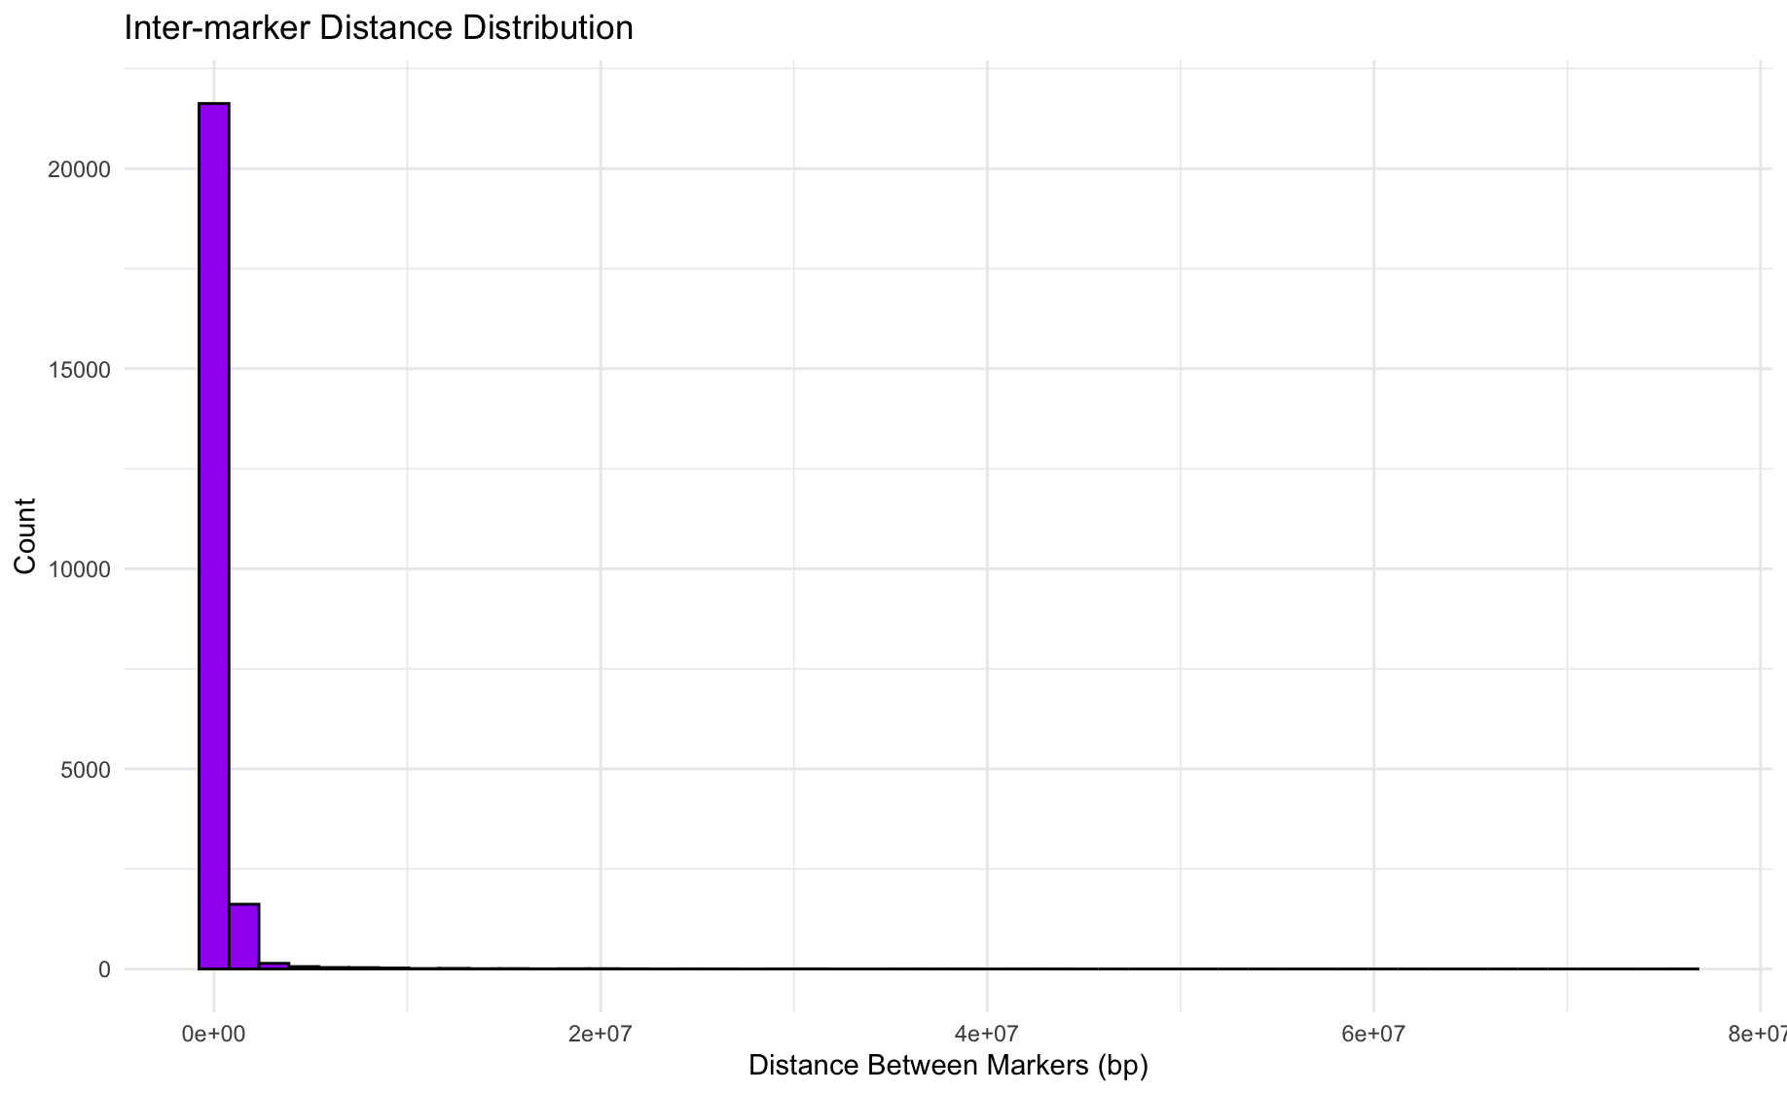
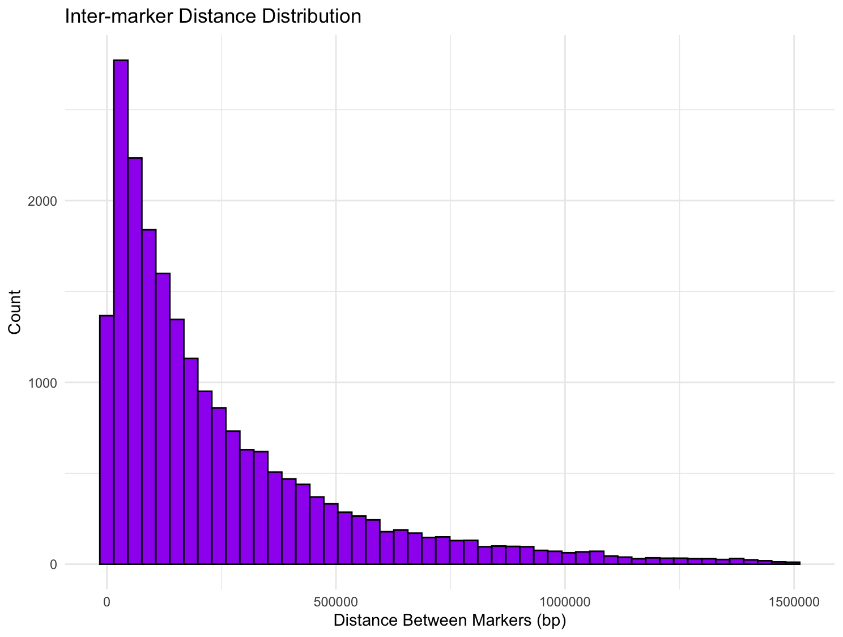
Filtered lengths <2500 bp, and <1.5 Mb

